Slide 1
Standard Template Library

Slide 2
Contents
Introduction to STL
Containers
Iterators
Algorithms
Function Objects

Slide 3
Introduction to STL
STL is standard Template Library
Powerful, template-based components
Containers : Template Data Structures
Iterators : Like pointers, Access elements of containers
Algorithms: Data manipulation, searching ,sorting etc.,
Object-Oriented Programming : Reuse – Reuse
STL is a huge class library

Slide 4
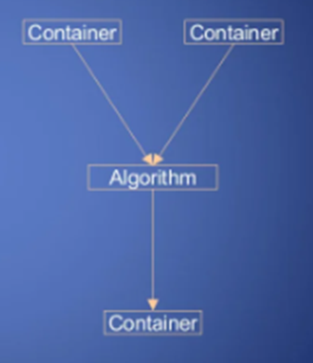
Overview of STL Components
Data storage, Data Access and algorithms are separated
Containers hold data
Iterators access data
Algorithms, function object manipulate data
Allocators – allocate data ( mostly we ignore)

Slide 5
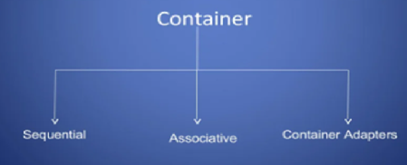
Containers
Container is a way that stored data is organized in memory for example an array of elements

Slide 6
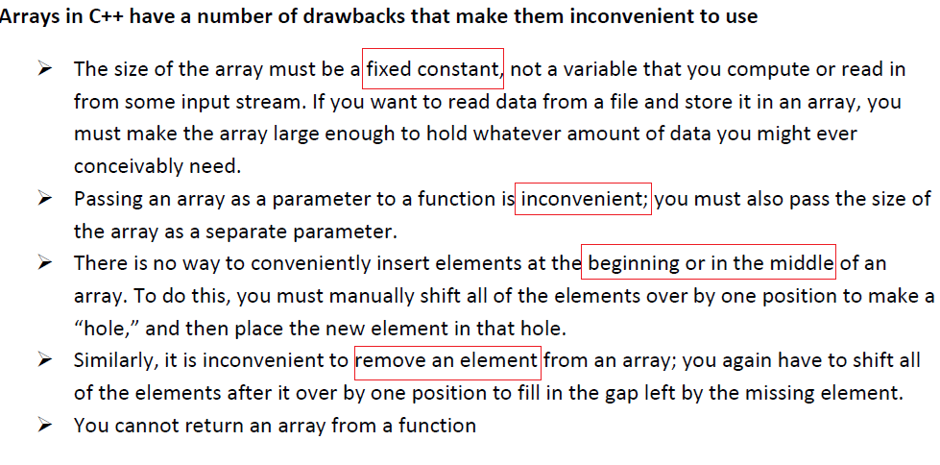

Slide 7
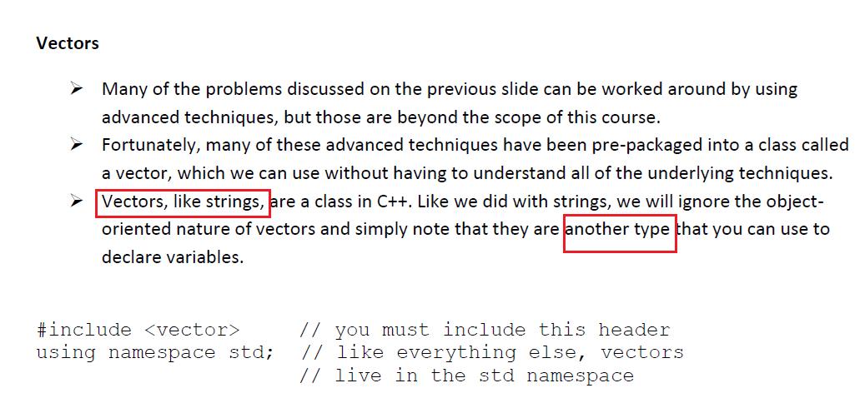

Slide 8
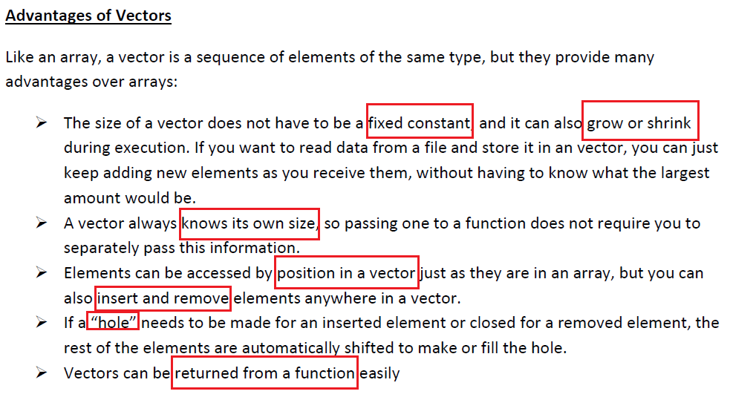

Slide 9
Container Conti….
Sequence Containers
Vector
Deque
List
Associative Container
Set
Multiset
Map
Multimap
Container adapters
Stack
Queue

Slide 10
Sequential Container
Vector<T> - Dynamic array
Offers random access, back insertion
Should be your default choice, but choose wisely
Backward compatible with C &v[0] points to the first element
Deque<T> - Double ended queue( usually array of arrays)
Offers random access, back and front insertion
Slower than vectors, no c compatibility
List <T> - ‘Traditional’ doubly linked list
Don’t expect random access, you can insert anywhere though

Slide 11
Functions of Vector class
-Size() - Provides the number of elements
-push_back() - appends an element to the end
-pop_back() - erases the last element
-begin() - Provides reference to the last element
- end() - Provides reference to the end vector

Slide 12
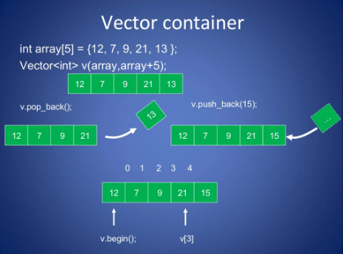

Slide 13
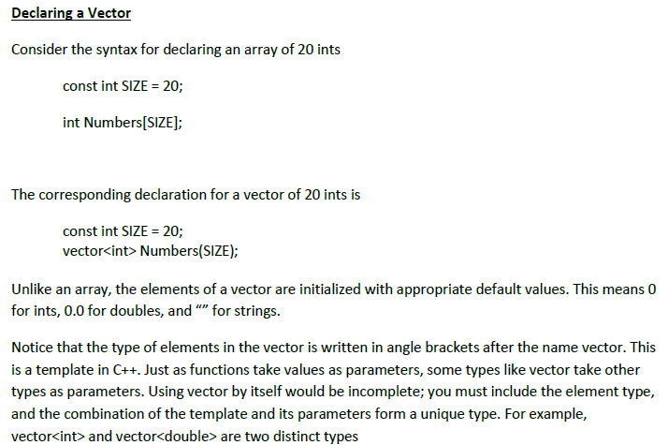

Slide 14
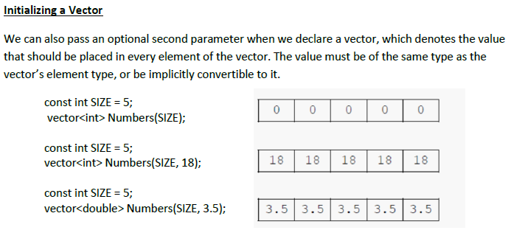

Slide 15
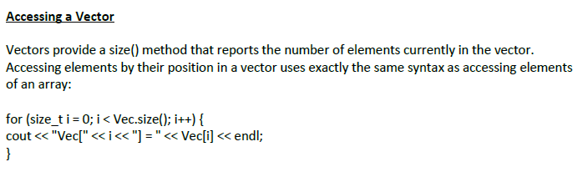
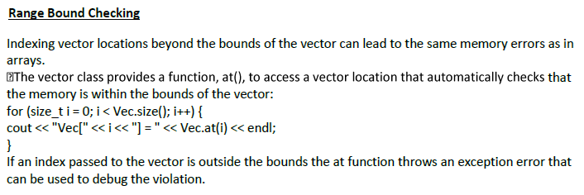

Slide 16
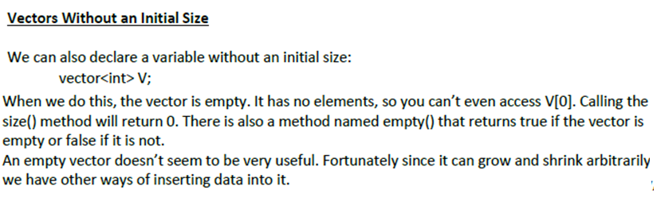
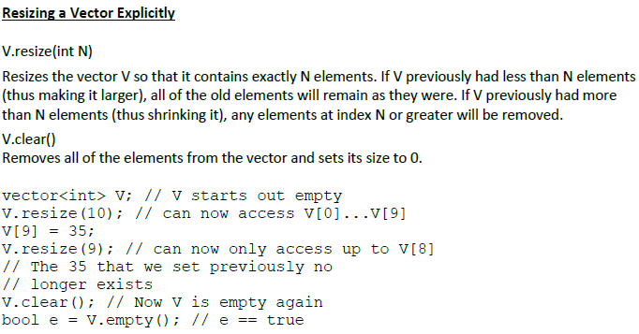

Slide 17
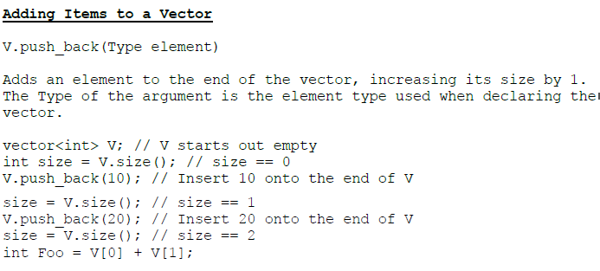

Slide 18
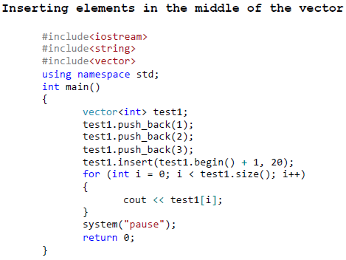
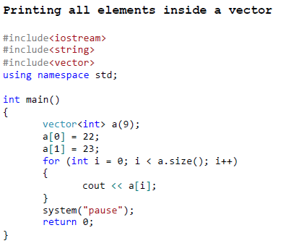

Slide 19
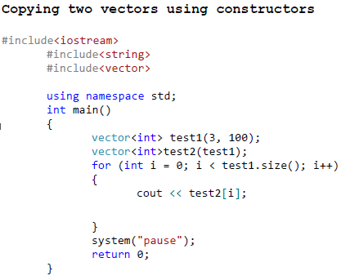
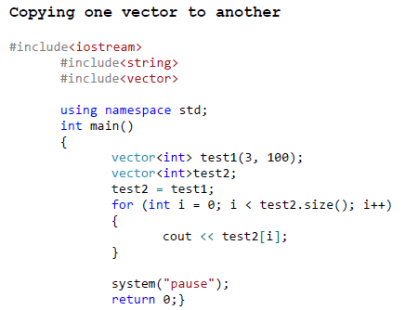
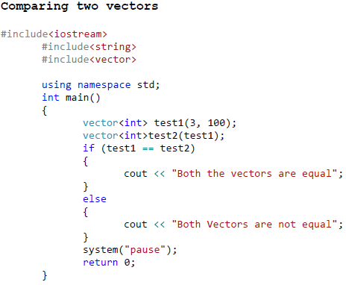
Output : 100100100
Output : 100100100
Output : Both the Vectors are equal

Slide 20
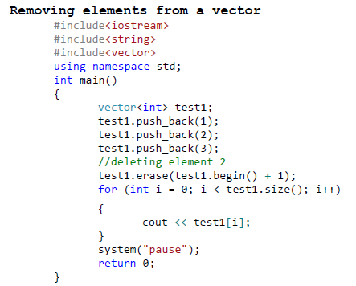
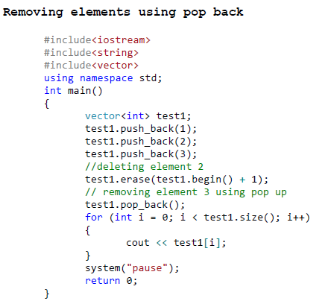
Output : 13
Output : 1

Slide 21
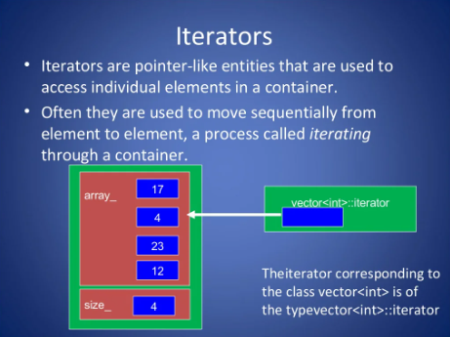

Slide 22
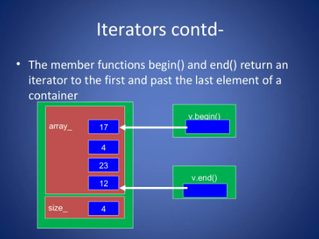

Slide 23
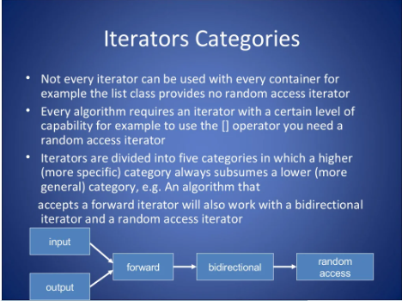

Slide 24
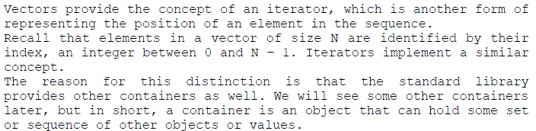
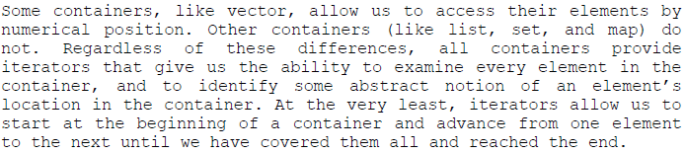
ITERATORS

Slide 25
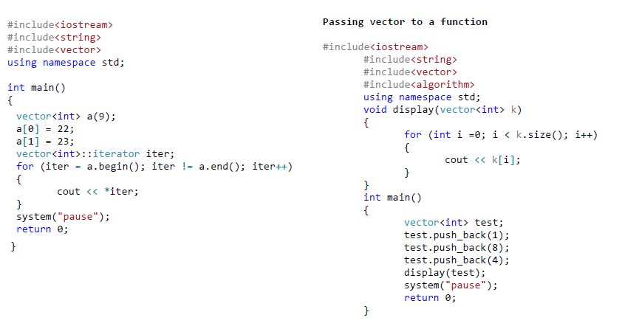
Output : 22230000000
Output : 184

Slide 26
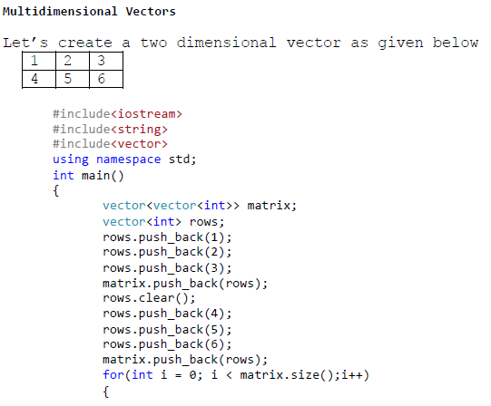
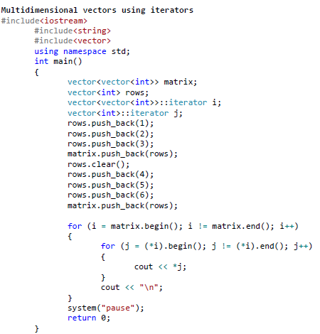
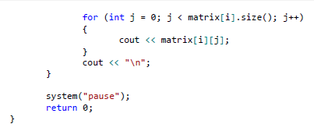
Output :
123
456
Output :
123
456

Slide 27
LISTS
Lists are sequence containers that allow non-contiguous memory allocation. As compared to vector, the list has slow traversal, but once a position has been found, insertion and deletion are quick.

Slide 28
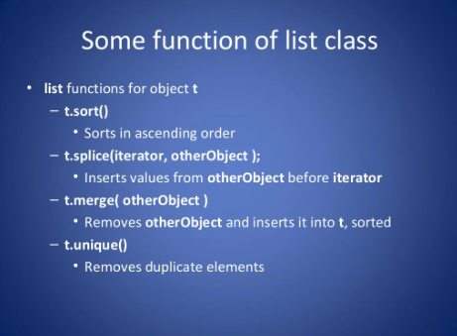

Slide 29
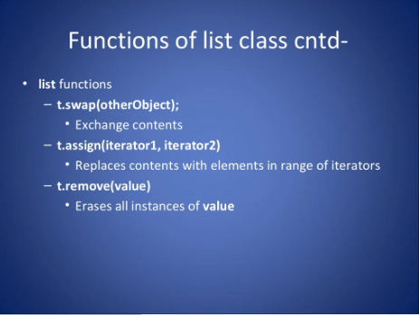

Slide 30
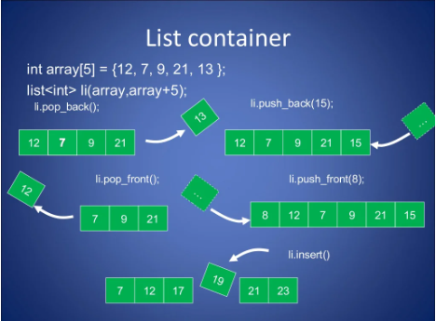

Slide 31
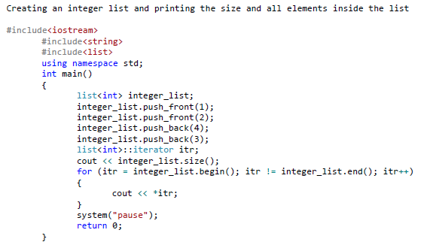
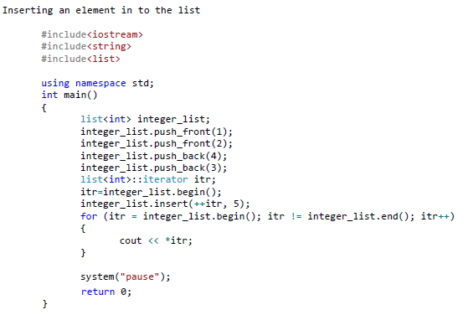

Slide 32
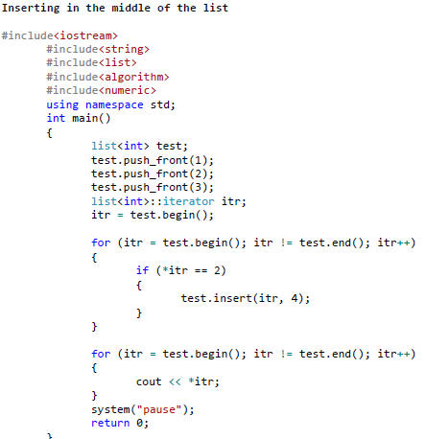
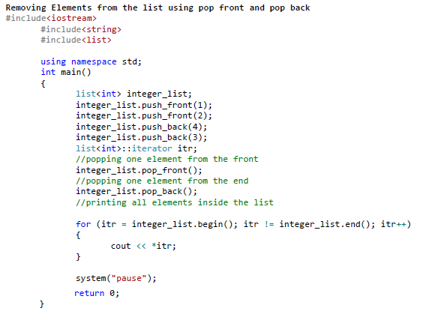

Slide 33
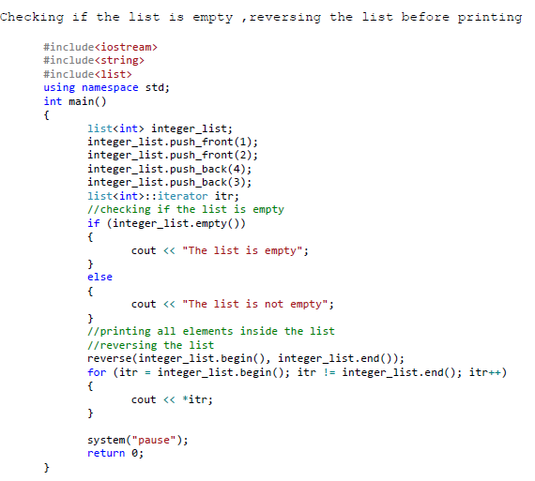

Slide 34
Algorithm
The header algorithm defines a collection of functions especially designed to be used on ranges of elements. They act on containers and provide means for various operations for the contents of the containers.

Slide 35
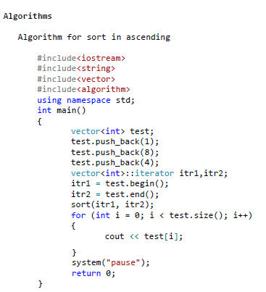
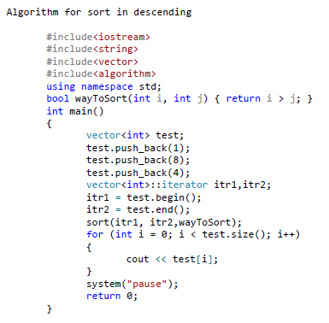

Slide 36
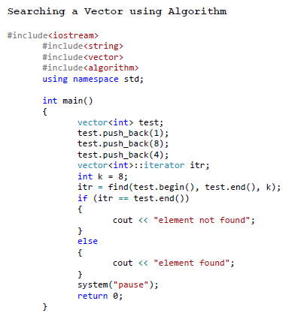

Slide 37
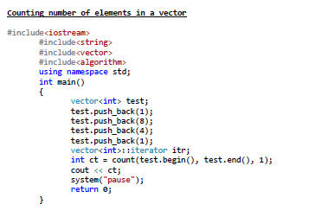
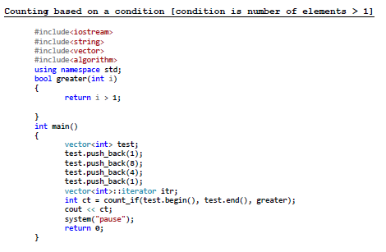

Slide 38
MAPS
Maps are associative containers that store elements in a mapped fashion. Each element has a key value and a mapped value. No two mapped values can have the same key values.
Some basic functions associated with Map:
begin() – Returns an iterator to the first element in the map.
end() – Returns an iterator to the theoretical element that follows the last element in the map.
size() – Returns the number of elements in the map.
max_size() – Returns the maximum number of elements that the map can hold.
empty() – Returns whether the map is empty.
pair insert(keyvalue, mapvalue) – Adds a new element to the map.
erase(iterator position) – Removes the element at the position pointed by the iterator.
erase(const g)– Removes the key-value ‘g’ from the map.
clear() – Removes all the elements from the map.

Slide 39
#include <iostream>
#include <iterator>
#include <map>
using namespace std;
int main()
{
// empty map container
map<int, int> gquiz1;
// insert elements in random order
gquiz1.insert(pair<int, int>(1, 40));
gquiz1.insert(pair<int, int>(2, 30));
gquiz1.insert(pair<int, int>(3, 60));
gquiz1.insert(pair<int, int>(4, 20));
gquiz1.insert(pair<int, int>(5, 50));
gquiz1.insert(pair<int, int>(6, 50));
gquiz1.insert(pair<int, int>(7, 10));
// printing map gquiz1
map<int, int>::iterator itr;
cout << "\nThe map gquiz1 is : \n";
cout << "\tKEY\tELEMENT\n";
for (itr = gquiz1.begin(); itr != gquiz1.end(); ++itr) {
cout << '\t' << itr->first << '\t' << itr->second << '\n';
}
cout << endl;
// assigning the elements from gquiz1 to gquiz2
map<int, int> gquiz2(gquiz1.begin(), gquiz1.end());
// print all elements of the map gquiz2
cout << "\nThe map gquiz2 after“ << " assign from gquiz1 is : \n";
cout << "\tKEY\tELEMENT\n";
for (itr = gquiz2.begin(); itr != gquiz2.end(); ++itr) {
cout << '\t' << itr->first << '\t' << itr->second << '\n';
}
cout << endl;
// remove all elements up to
// element with key=3 in gquiz2
cout << "\ngquiz2 after removal of"
" elements less than key=3 : \n";
cout << "\tKEY\tELEMENT\n";
gquiz2.erase(gquiz2.begin(), gquiz2.find(3));
for (itr = gquiz2.begin(); itr != gquiz2.end(); ++itr) {
cout << '\t' << itr->first << '\t' << itr->second
<< '\n';
}

Slide 40
Output
The map gquiz1 is :
KEY ELEMENT
1 40
2 30
3 60
4 20
5 50
6 50
7 10
The map gquiz2 after assign from gquiz1 is :
KEY ELEMENT
1 40
2 30
3 60
4 20
5 50
6 50
7 10
// remove all elements with key = 4
int num;
num = gquiz2.erase(4);
cout << "\ngquiz2.erase(4) : ";
cout << num << " removed \n";
cout << "\tKEY\tELEMENT\n";
for (itr = gquiz2.begin(); itr != gquiz2.end(); ++itr) {
cout << '\t' << itr->first << '\t' << itr->second << '\n';
}
cout << endl
return 0;
}

Slide 41
gquiz2 after removal of elements less than key=3 :
KEY ELEMENT
3 60
4 20
5 50
6 50
7 10
gquiz2.erase(4) : 1 removed
KEY ELEMENT
3 60
5 50
6 50
7 10

Slide 42
USE OF ACCUMULATE
#include <iostream>
#include<string>
#include<vector>
#include<algorithm>
#include<numeric>
using namespace std;
int main()
{
vector<int>test;
test.push_back(1);
test.push_back(8);
test.push_back(4);
test.push_back(1);
//vector<int>::iterator itr;
int sum=accumulate(test.begin(),test.end(),0.0);
cout <<sum;
return 0;
}
Output :
14

